Slide 1
JANUARY 4, 2019 USPTO GUIDELINES ON COMPUTER-IMPLEMENTED FUNCTIONAL CLAIM LIMITATIONS FOR COMPLIANCE WITH SECTION 112: HOW MUCH IS ENOUGH?
Presented by
Patrick G. Burns
Delegate For The Intellectual Property Law Association of Chicago (IPLAC)
_____
JPAA – March 2019
Copyright Greer Burns & Crain, Ltd. 2019©

Slide 2
Table of Contents
Summary of the Guidelines
How much do we need to satisfy § 112?
Possible issues for the future
Effect of algorithms on claim construction

Slide 3
I. SUMMARY OF THE GUIDELINES
The focus is on claim limitations, and the specification as it relates to the functional claim limitations.
We should assume that § 112(f) will apply to computer-implemented processes.
For computer-implemented § 112(f) claim limitation, the specification must disclose an algorithm for performing the claimed specific computer function, or else the claim is indefinite under § 112(b).
The algorithm requirement cannot be avoided by arguing that one of ordinary skill in the art is capable of writing software to convert a general purpose computer to a special purpose computer to perform the claimed function.

Slide 4
The algorithm must address the entire claimed function.
Sufficiency of the algorithm is determined in view of what one of ordinary skill would understand as sufficient to define the structure and make the boundaries of the claim understandable.
Even if § 112(f) does not apply, computer implemented functional claim language must be evaluated written description and enablement.
The level of detail required to satisfy the written description requirement varies depending on the nature and scope of the claims and on the complexity and predictability of the technology. Information that is well-known in the art need not be described in detail in the specification. However, sufficient information must be provided to show that the inventor had possession of the invention as claimed.

Slide 5
The specification need not disclose what is well-known in the art. This is of particular importance with respect to computer implemented inventions due to the high level of skill in the art and the similarly high level of predictability in generating programs to achieve an intended result without undue experimentation.

Slide 6
II. HOW MUCH DO WE NEED TO SATISFY § 112?

Slide 7
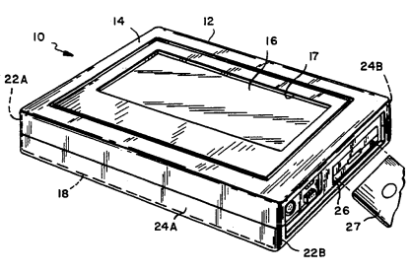
Typhoon Touch Techs., Inc. v. Dell, Inc., 659 F.3d 1376 (Fed. Cir. 2011)
Enough / Not Enough
U.S. Patent No. 5,379,057: a computer user can combine features of libraries
Claim 5: “means for cross-referencing said responses with one of the libraries of said possible responses”
Specification:
“Cross-referencing entails the matching of entered responses with a library of possible responses, and, if a match is encountered, displaying the fact of the match, otherwise alerting the user, or displaying information stored in memory fields associated with that library entry.”
‘057 patent, col. 3 ll. 43-48.
“Cross-Referencing imports that, for each answer field, the entered response can be related to a library to determine if the response in the answer field is existent in the library. In other words, the answer information is cross-referenced against that specific library. If it is available in that library, then, corresponding to that library entry, an action is executed. For instance, the associated action can involve an overlay window that alerts the user of the fact of the match with the library entry, or displays the contents of an information field stored in association with that entry in the memory.”
‘057 patent, col. 14 l. 57 to col. 15 l. 4.
Held: Description sufficient structure; inclusion of computer code not required; algorithm can be recited in prose

Slide 8
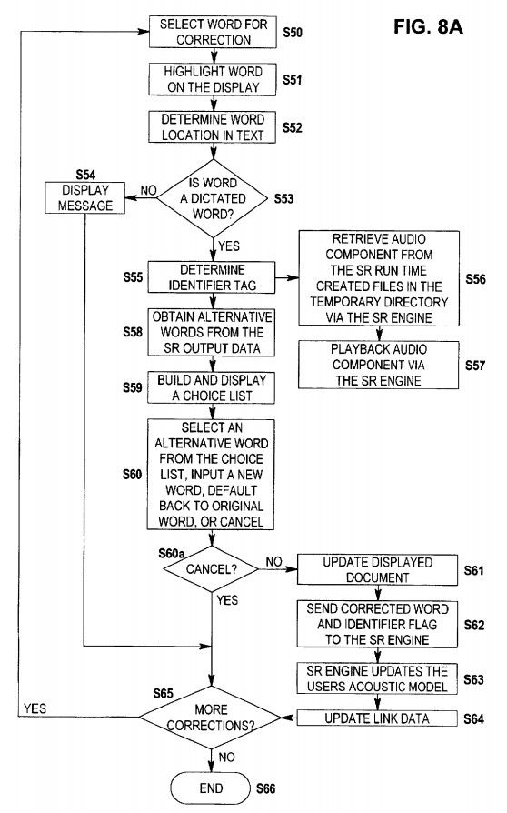
AllVoice Computing PLC v. Nuance Communs., Inc., 504 F.3d 1236 (Fed. Cir. 2007)
Enough / Not Enough
U.S. Patent No. 5,799,273: interface between speech recognition engine and end-user application programs on a personal computer (e.g., Word)
Claim 61: “means, independent of the one computer-related application, for forming link data linking a portion of the audio data to at least one the recognized words independently of the one computer-related application . . . and means, independent of the one computer-related application, for updating the position identifiers in response to changes in positions of the recognized words within the one computer-related application.”
Specification: “The speech recognition interface application 12 receives the recognized word . . . and outputs the word using the dynamic data exchange (DDE) protocol in the Windows operating system.”
Held: sufficient algorithmic structure for independent means where one of ordinary skill in the art could use well-known Windows operating features (messages, function calls, hooking)

Slide 9
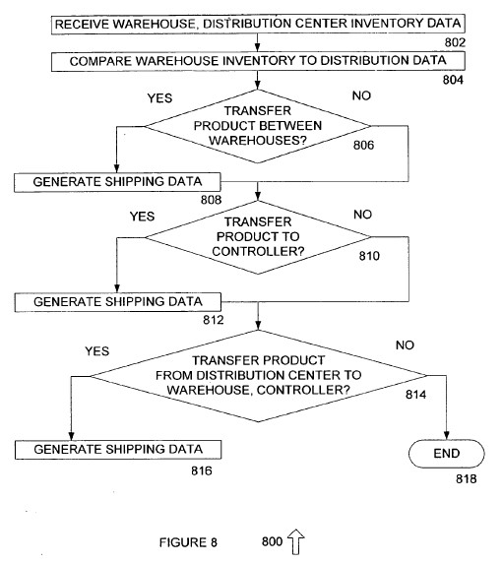
In re Aoyama, 656 F.3d 1293 (Fed. Cir. 2011)
Enough / Not Enough
Patent: a system for management of supply chain data for multiple warehouses
U.S. Patent Application No. 10/798,505; claims 11-12.
Claim: “reverse logistics means for generating transfer data”
Specification: “At 804 warehouse inventory data and distribution inventory data is compared. The method then proceeds to 806 where it is determined whether it is necessary to transfer a product between warehouses . . . If it is determined at 806 that product transfer between warehouses is not required the method proceeds to 810. Otherwise, the method proceeds to 808 where shipping data is generated and transmitted to an appropriate location, such as a warehouse, a shipper, or other suitable locations.” [0090]
Held: Figure 8 and description failed to disclose how a computer could be programmed to produce a structure that generated shipping data

Slide 10
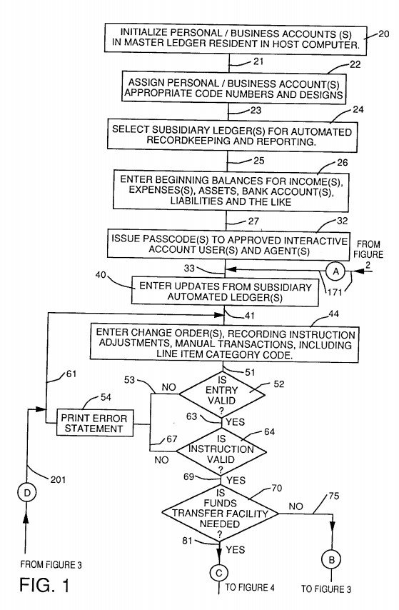
Noah Sys. Inc. v. Intuit Inc., 675 F.3d 1302 (Fed. Cir. 2012)
Enough / Not Enough
U.S. Patent No. 5,875,435: automated accounting system allowing a business or individual to connect to the computers of others for transfer of financial information
Claim 12: “means for providing access to said file of said financial accounting computer for said first entity and/or agents of said first entity so that said first entity and/or said agent can perform one or more activities selected from the group consisting of entering, deleting, reviewing, adjusting and processing said data inputs”
Means for providing access to the file – sufficient algorithmic structure
Means for enabling performance of specified operations – insufficient
Specification: “line 27 leads to box 32 where passcodes are issued to approved interactive account user(s) and agent(s) . . . This access to the master ledger . . . allows the agents to perform activities selected from the group consisting of entering, deleting, reviewing, adjusting and processing data inputs in the master ledger . . . Line 41 then leads to box 44 where the access to the data inputs in the master ledger is set forth. This access can be provided to interactive users and agents of the first entity. At this box 44, change orders, recording instruction adjustments, manual transactions and the like can be entered.” [col. 4, ll. 47-49, 53-57; col. 6, ll. 16-20]
Held: lack of sufficient algorithmic structure disclosed to enable a user to perform the functions described and represented in box 44

Slide 11
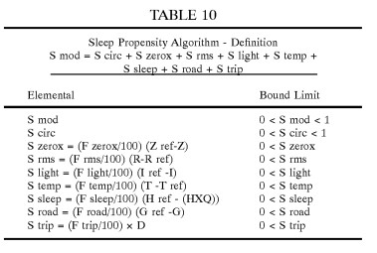
Ibormeith IP, LLC v. Mercedes-Benz USA, LLC, 732 F.3d 1376 (Fed. Cir. 2013)
Enough / Not Enough
U.S. Patent No. 6,313,749: a sleepiness monitor for a vehicle driver
Claim 1: “computational means for weighting the operational model according to time of day in relation to the driver or operator circadian rhythm pattern(s) and for deriving from the weighted model, driver or operator sleepiness condition and producing an output thereby”
Specification:
“[A] monitor taking account of circadian and sleep parameters of an individual vehicle driver, and/or generic or universal human physiological factors, applicable to a whole class or category of drivers, is integrated with ‘real-time’ behavioural sensing, such as road condition and driver control action, including steering and acceleration, to provide an (audio-) visual indication of sleepiness.” [col. 2, ll. 55-62]
“Overall system capability could include one or more of such factors as: common, if not universal, underlying patterns or sleepiness . . . exacerbating personal factors . . . such as recent sleep patterns especially, recent sleep deprivation and/or disruption; with a weighting according to other factors, such as the current time of day.” [col. 3, ll. 5-14]
Held: Affirming invalidity for insufficient algorithmic structure
732 F.3d at 1382, “Table 10 merely lists inputs without specifying any single formula or function or algorithm defining the contribution of any of the inputs to a computation.”

Slide 12
III. HOW TO PREPARE FOR THE FUTURE
Undue experimentation
Level of skill
Possession of the invention
The specification need not disclose what is well-known in the art. This is of particular importance with respect to computer implemented inventions due to the high level of skill in the art and the similarly high level of predictability in generating programs to achieve an intended result without undue experimentation.

Slide 13
IV. CLAIM CONSTRUCTION

Slide 14
Thank you!
Patrick G. Burns pburns@gbc.law
Direct: (312) 987-4001
Edward Mahan contributed to this presentation

